Slide 1
CGB1201 – JAVA PROGRAMMING
FINAL REVIEW
Department of Artificial Intelligence and Machine Learning
Academic Year: 2024 – 2025 (Odd Semester)
Register Number : BHUVANASRI T
Name : 927624BAM006
Year : II
Semester : III
Date : 16-12-2025

Slide 2
Title of the Project
E-CHALLAN GENERATOR AND TRAFFIC VIOLATION TRACKER

Slide 3
Abstract
The E-Challan Generator and Traffic Violation Tracker is a digital system designed to automate the detection of traffic violations and generation of electronic challans. The project efficiently records violation details, tracks offender history, and reduces manual intervention. By ensuring accurate monitoring and quick challan issuance, the system improves traffic law enforcement, enhances transparency, and supports safer road management.

Slide 4
Abstract with CO/PO Mapping
Abstract | CO | POs | PSO
The project E-Challan Generator and Traffic Violation Tracker is designed to automate the detection of traffic violations and the generation of digital challans. Using AI and computer vision techniques such as Automatic Number Plate Recognition (ANPR), the system identifies vehicles involved in offenses like overspeeding and signal jumping. It then retrieves vehicle details from the RTO database, calculates fines, and issues digital challans through SMS or email. This reduces manual workload, minimizes errors, ensures transparency, and promotes safer driving habits. | CO1 CO2 CO3 | PO2 PO3 PO5 PO9 PO10 | PSO1 PSO2

Slide 5
Introduction
The E-Challan Generator and Traffic Violation Tracker is developed to modernize traffic law enforcement by replacing manual challan systems with an automated digital solution. The project focuses on accurately identifying traffic violations, generating e-challans instantly, and maintaining a centralized record of offenders. This system reduces paperwork, minimizes human errors, saves time, and improves efficiency for traffic authorities while ensuring better compliance with traffic rules.

Slide 6
Java Programming - Concepts Used
Swing Framework – For GUI creation
Event Handling – For button actions and form submissions
Object-Oriented Programming – Using classes for driver, vehicle, and violation details
Exception Handling – To handle invalid inputs and missing records
File Handling / Collections – To store challan records
Layouts – For organizing UI components effectively

Slide 7
Proposed Architecture
USER INTERACTION LAYER
BUSINESS LOGIC LAYER
DATA LAYER
FUTURE SCOPE
SECURITY LAYER

Slide 8
Proposed Architecture - Description
User Interface Layer: Java Swing GUI for officers to input violation details and view challans
Business Logic Layer: Handles calculation of fine amounts, generation of challan IDs, and updating payment status
Data Layer: Stores driver, vehicle, and challan details using files or collections. Can later be connected to MySQL or Firebase database.
Security Layer: Officer login system ensures only authorized users can issue challans
Future Scope: Integration with camera-based detection. Online payment portal. SMS/Email challan notification system

Slide 9
List of Modules
Login and Authentication Module
Vehicle and Driver Record Module
Violation Entry Module
E-Challan Generation Module
Payment and Record Management Module
Admin Dashboard Module

Slide 10
Module Description
Login and Authentication Module
Allows authorized officers to log in securely using username and password.
2. Vehicle and Driver Record Module
Stores and retrieves driver and vehicle details for quick access.
3. Violation Entry Module
Enables officers to select violation type, calculate fine amount, and submit challan.

Slide 11
Module Description
4. E-Challan Generation Module
Automatically generates a digital challan with unique ID and stores it in the record.
5. Payment and Record Management Module
Allows officers to update payment status and view pending challans.
6. Admin Dashboard Module
Displays summary statistics like total challans issued, collected fines, and violations.

Slide 12
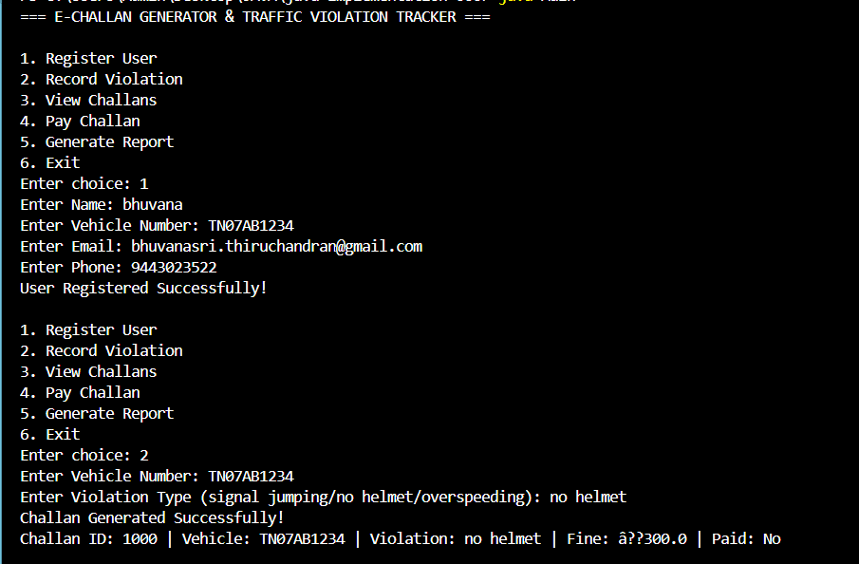
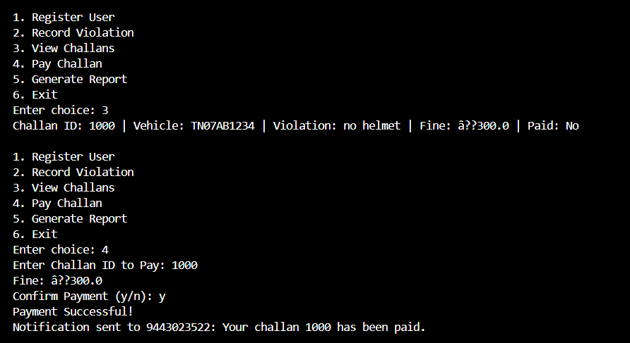
Results and Discussion

Slide 13
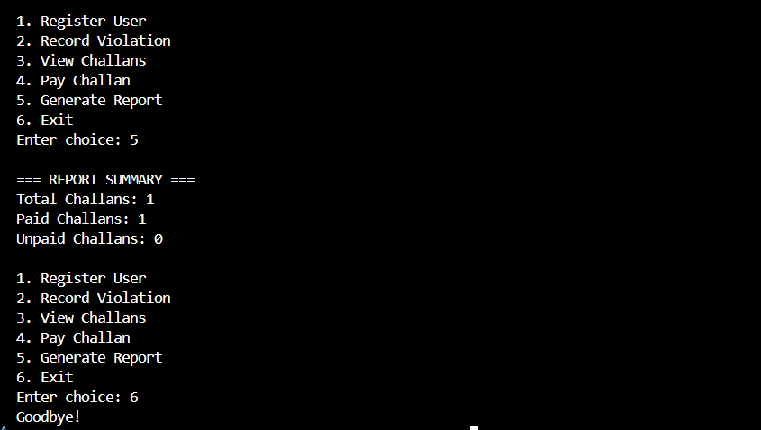
Results and Discussion

Slide 14
Results and Discussion (Cont..)
The system successfully automates the manual challan generation process. Officers can efficiently record traffic violations, generate receipts instantly, and maintain accurate digital records. The application ensures transparency, minimizes human error, and allows easy tracking of unpaid challans.
Test cases show that the system correctly calculates fines based on violation type and ensures secure access through the login module. The GUI design offers a clean, easy-to-use interface for non-technical users.

Slide 15
Conclusion
The E-Challan Generator and Traffic Violation Tracker project demonstrates how Java can be used to build real-world administrative solutions. It simplifies traffic law enforcement, improves data management, and enhances transparency. Future developments could include GPS-based location tagging, camera integration, and real-time dashboards for higher authorities. The system has potential for large-scale deployment in smart city projects.

Slide 16
Thank You
ANY QUERIES???

